Slide 1
BSCS (R) FINAL YEAR PROJECT (2022-26)
Automated
Multi-Agentic Trading System
OpenAI Agents SDK · Neon PostgreSQL · Langfuse Telemetry
Ahmad Abdullah (COMPF22BSR43)
Abdul Qadeer Khan (COMPF22BSR47)
Faisal Rehman (COMPF22BSR29)
Department of Computer Science & Information Technology
Notes:
Welcome. Today we present our BSCS final year thesis: Automated — A Multi-Agentic Trading System. Built by Abdul Qadeer Khan and Ahmad Abdullah, this system brings AI-powered technical analysis to trading through a fully decoupled multi-agent architecture.

Slide 2
Problem Statement
THE CHALLENGE
No intelligent, agentic technical analyst exists for retail traders.
Retail traders lack access to institutional-grade technical analysis tools
Existing trading bots are either rigid rule-based scripts or single monolithic AI prompts
A single AI prompt handling all trading logic creates context contamination: the analyst role, risk role, and routing role interfere with each other.
There is no system that behaves like a real trading desk with specialized agents for analysis, compliance, and routing working independently.
Without automated risk guardrails, retail traders have no structured enforcement mechanism to prevent overexposure or emotional trading decisions.
Notes:
The core problem: retail traders have no access to an intelligent, agentic system that mimics a professional trading desk. Current solutions are either too rigid or too monolithic. We set out to build a system with true agent specialization.

Slide 3
Our Solution
Automated Multi-Agentic Trading System
A decoupled, asynchronous multi-agent portal that acts as your personal AI trading desk.
Specialist Agents
Real Analysis
Risk Guardrails
Three purpose-built agents Market Analyst, Risk Manager each with a single bounded responsibility
No agent contaminates another's context true sandboxed execution
Live yfinance data feed with RSI, EMA, MACD, and SMA computed in real time
Outputs actionable signals: entry price, stop loss, take profit targets
Automated APPROVED / REJECTED compliance verdict on every trade proposal
Hard override to HOLD + 0% position sizing on rejection capital is preserved
Notes:
Our solution is a fully decoupled three-agent system: the Master Desk Router handles user input, the Analyst computes technical signals, and the Risk Manager enforces compliance. Together they replicate a professional trading desk — in software.

Slide 4
Basic Idea: How the Agents Work
01
02
03
Master Trading Desk Manager
Market Analyst Agent
Risk Manager Agent
Orchestrator & Gateway
Quantitative Signal Engine
Compliance Auditor & Final Gate
First contact point receives raw user intent from the portal
Validates and standardizes ticker symbols (AAPL, BTC-USD)
Locks in asset identity + timeframe before anything moves forward
Routes the confirmed request downstream no analysis here
Consumes live OHLCV data from yfinance for the locked ticker
Computes RSI, EMA (9/21/50/200), MACD, SMA indicator matrix
Outputs a structured signal: trend, momentum, support/resistance
Zero execution authority analysis only, never issues buy/sell
Receives the analyst signal and audits it against safety thresholds
Calculates precise stop-loss and take-profit math for the strategy
Issues a hard APPROVED or REJECTED verdict no grey area
On REJECTED: forces HOLD + 0% position sizing override
Notes:
Three agents, three strict roles. The Router is the gatekeeper — it never analyses. The Analyst computes the full technical picture but cannot execute. The Risk Manager has the final say — it either approves with calculated targets or rejects with a hard HOLD override. This separation is what makes the system reliable.

Slide 5
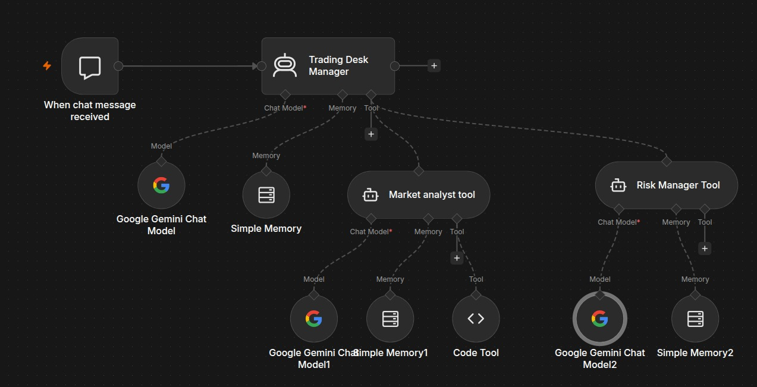
System Workflow
AGENT ORCHESTRATION DIAGRAM
Data Flow Steps
1
User Input
Operator sends ticker + Time-frame
2
Router Validates
Master Desk locks parameters, routes downstream
3
Analyst Computes
Fetches Candle, runs RSI/EMA/MACD matrix
4
Risk Audits
Compliance check → APPROVED or REJECTED
5
DB Persists
Decision + trade log saved to Neon PostgreSQL
6
UI Updates
Portal reflects verdict, chart, and signals
Notes:
The workflow starts with the operator sending a ticker and strategy from the portal. The Router validates and routes, the Analyst fetches live data and computes indicators, the Risk Manager issues a compliance verdict, the result is persisted to Neon PostgreSQL, and the UI reflects everything in real time.

Slide 6
Tech Stack
BACKEND
FRONTEND
DATA & INFRA
Python 3.12 + FastAPI
HTML5 + JavaScript
yfinance
ASGI web server, route handlers, dependency injection
Single-page operator dashboard, event-driven UI
Live OHLCV market data: stocks and crypto tickers
OpenAI Agents SDK
Tailwind CSS
Neon PostgreSQL
Multi-agent orchestration, tool binding, handoffs
Bloomberg-inspired dark utilitarian styling
Serverless cloud DB — users, trade logs, audit trail
SQLAlchemy ORM + Pydantic
SVG Candlestick Chart
Langfuse
Database models, validation schemas, type safety
Custom real-time chart with 10-second polling
Distributed tracing, token usage, agent latency SLAs
passlib[bcrypt] + uv
Render
Password hashing, fast dependency management
Cloud deployment — zero-config ASGI hosting
Notes:
The backend is Python FastAPI with the OpenAI Agents SDK powering multi-agent orchestration. SQLAlchemy handles the ORM layer and Pydantic enforces validation. The frontend is a Bloomberg-inspired HTML/JS/Tailwind single-page dashboard. Data comes from yfinance, persistence from Neon PostgreSQL, observability from Langfuse, and deployment from Render.

Slide 7
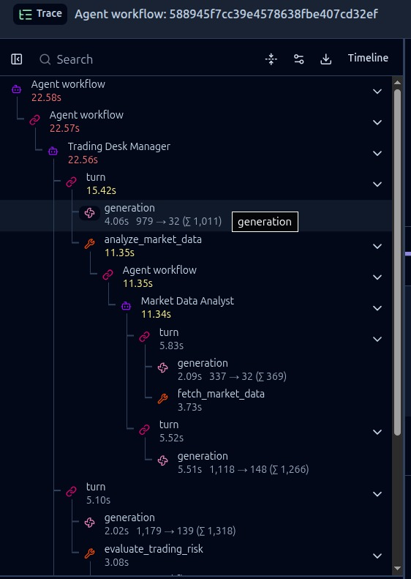
Observability
Notes:
The backend is Python FastAPI with the OpenAI Agents SDK powering multi-agent orchestration. SQLAlchemy handles the ORM layer and Pydantic enforces validation. The frontend is a Bloomberg-inspired HTML/JS/Tailwind single-page dashboard. Data comes from yfinance, persistence from Neon PostgreSQL, observability from Langfuse, and deployment from Render.

Slide 8
Key Terminologies & Strategy Indicators
RSI (14)
EMA
Relative Strength Index — momentum oscillator 0–100. Above 70 = overbought, below 30 = oversold.
Exponential Moving Average — price trend tracker that weights recent data more heavily than older data.
MACD
SMA
Moving Average Convergence Divergence — trend-following momentum indicator showing signal crossovers.
Provides the Average price of stock in the particular time frame.
Stop Loss
Take Profit
Maximum loss threshold — if price drops to this level, exit the trade to preserve capital.
Target gain exit — lock in profit when price reaches this level before the move reverses.
DYNAMIC STRATEGY MATRIX
Strategy | Timeframe | Lookback | Indicators | Stop Loss | Take Profit
Intraday Scalp | 15m | 7 days | 9-EMA, 21-EMA, RSI(14) | -1.0% | +2.0%
Intraday Swing | 1h | 30 days | 9-EMA, 21-EMA, RSI(14) | -2.5% | +5.0%
Medium Swing | 4h | 60 days | 50-MA, MACD, RSI(14) | -4.0% | +8.0%
Macro Position | 1d | 180 days | 50-MA, 200-MA, Macro RSI | -8.0% | +15.0%
Notes:
Key indicators the system uses: RSI measures momentum, EMA tracks trend direction, MACD shows trend shifts, VWAP benchmarks institutional price. Four strategies are supported from 15-minute scalping to 180-day macro positions, each with its own lookback period and exit bounds.

Slide 9
Frontend: The Operator Dashboard
UI IS THE WINDOW — BACKEND IS THE BRAIN
A Bloomberg-inspired, industrial-utilitarian single-page dashboard built with HTML5, JavaScript, and Tailwind CSS — designed to surface agent intelligence, not to be the product.
Live SVG Candlestick Chart
Quick-Select Asset Badges
Agent Output Panel
Secure Auth Portal
Real-time candles rendered in pure SVG
no external chart lib
Color-coded: green bull / orange bear bodies + wicks
One-click stocks: AAPL, NVDA, TSLA, MSFT
One-click crypto: BTC-USD, ETH-USD, SOL-USD
Instantly loads ticker into the agent pipeline
Displays Manager + Analyst + Risk Manager output
APPROVED shown in green, REJECTED in red/orange
Live stop-loss, take-profit, and entry targets
Full sign-up / login with bcrypt hashing
Pakistani/International phone regex validation
Session-aware agents tied to authenticated user
Notes:
The frontend is intentionally minimal — its job is to surface agent intelligence, not to be the product. It's a Bloomberg-inspired dark dashboard with a live SVG candlestick chart, quick-select asset badges, and a real-time agent output panel. The backend does the heavy lifting; the UI just makes it accessible.

Slide 10
Cloud Deployment: Render
DEPLOYED ON RENDER.COM
1
2
3
Build Command
Start Command
Cold Start Handling
pip install -r requirements.txt
uvicorn main:app --host 0.0.0.0 --port $PORT
Free tier spins down after 15 min idle
All deps pinned in requirements.txt / pyproject.toml
Python 3.12 runtime on Render infrastructure
Env vars (DB URL, API keys) injected via Render dashboard
FastAPI served via Uvicorn ASGI server
$PORT dynamically bound by Render at runtime
0.0.0.0 binding exposes service to the public web
First request causes ~30-60s spin-up delay
Startup runs idempotent DB migration on every boot
Two isolated connection blocks prevent transaction aborts
Neon PostgreSQL serverless connection pool handles Render container lifecycle gracefully on every cold start.
Notes:
Deployment is on Render using a standard ASGI setup. The build command installs all dependencies, the start command launches Uvicorn on Render's dynamic PORT. The key engineering challenge is the free-tier cold start — our idempotent, transaction-isolated startup migration handles this reliably on every boot.

Slide 11
Thank You
Automated Multi-Agentic Trading System
BSCS Final Year Project — Department of Computer Science & Information Technology — (2022-26)
Ahmad Abdullah (COMPF22BSR43)
Abdul Qadeer Khan (COMPF22BSR47)
Faisal Rehman (COMPF22BSR29)
Any Questions <3
Notes:
Thank you for your time and attention. We are now ready to address your questions. We welcome any technical or conceptual questions about our multi-agent architecture, indicator logic, deployment, or academic contributions.

